Slide 1

Python Hackathon Aug 2023
TEAM – DATA EAGLES
Akila Ramaswamy
Usha KIran Aravindakshan
Pratyusha Anireddy
Mahalakshmi Sriram

Slide 2
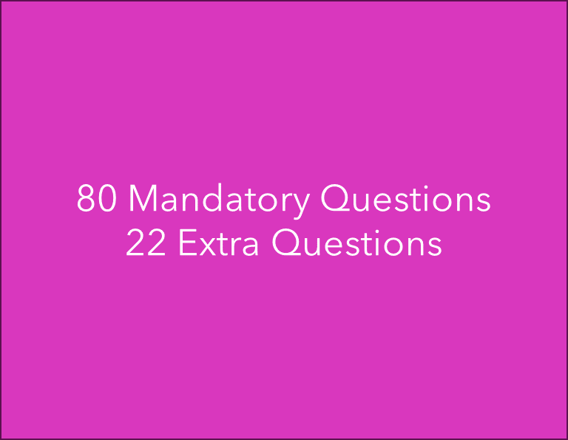
Approach Taken:
Understanding of the data
Importing required libraries & data at once in the beginning.
Implementation of Agile Methodology

Slide 3
Learnings From Mandatory Questions
Getting practice with the syntax for using pandas, numpy, seaborn & matplotlib libraries.
01
Learnt new functions that we weren’t aware before such as – iterrows(), idmax(), value_counts(), size() and new concepts like pivot tables etc.
02
Improvised our skills for coming up with the logic to solve programming questions.
03

Slide 4

Learnings from additional analysis
Learnt about different statistical and ML algorithms.
Practiced applying and interpreting the results of these algorithms.
Tried a few different charts such as the butterfly chart
Furthermore, were able to derive new insights from the data with our additional analysis.

Slide 5

Challenges we faced
Python coding & the libraries, functions & methods used for data analysis were new , so ended up needing more time than anticipated.
Debugging was also challenging due to our lack of understanding of different errors.
Establishing SQL connection from Python.
Managing the meetings for review along with our personal challenges/schedule was not always easy.

Slide 6
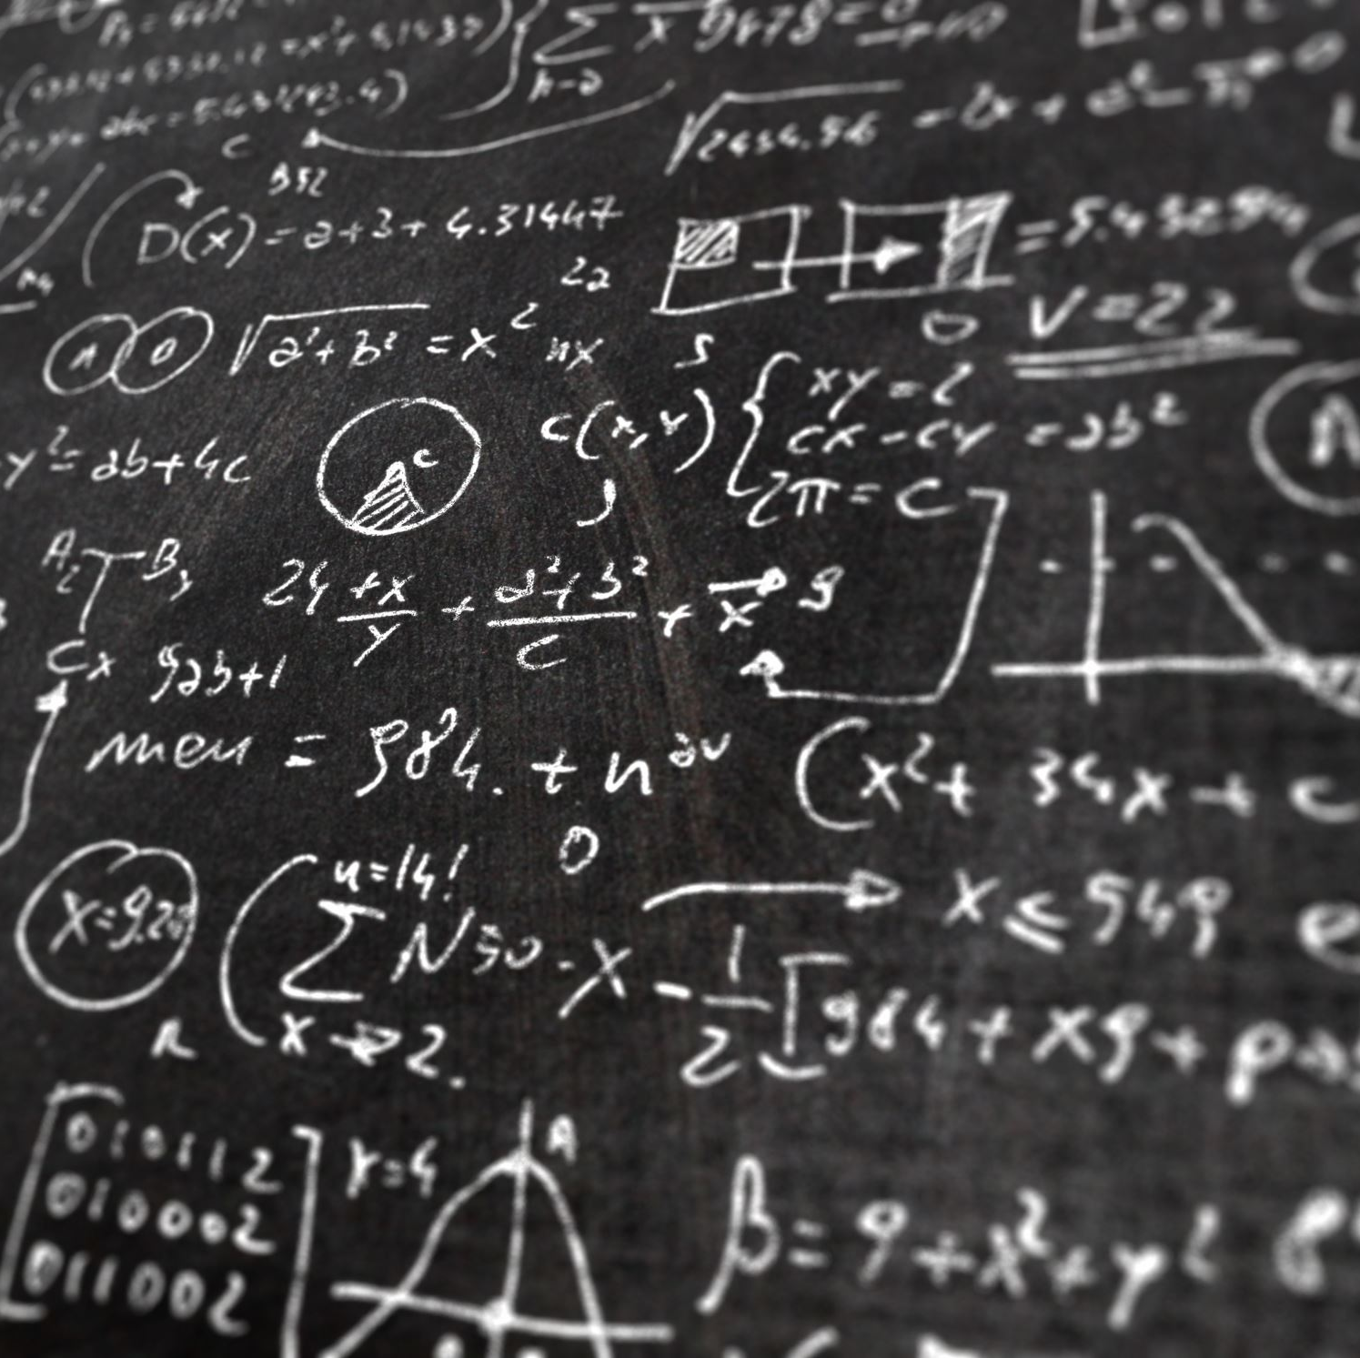
Our future learning goals:
Our plan going forward is to practice questions akin to those we’ve answered as part of the hackathon to develop more familiarity/ proficiency in Python.
In addition, we wish to learn about creating an interactive dashboards, and also about different data analysis techniques like the hypothesis testing & different ML algorithms.
Thank You

